Slide 1


SMART RADAR EQUIPMENT HEALTH MONITORING
ELEVIUM HACKATHAN 2026
Create embedded vibration +thermal monitoring for electronic enclosures with anomaly detection dashboard
TEAM MEMBERS
SHASHTHIKA – 9925005153
NAVANEETHAN – 9925005154
SRIRAM – 9925005150
SRINIVASAN - 9925005147

Slide 2
Introduction
- Radar equipment and electronic enclosures require continuous monitoring to ensure reliable and safe operation.
- Excessive temperature and abnormal vibration can indicate potential faults in electronic components.
- Traditional inspection methods may not identify equipment abnormalities at an early stage.
- The proposed system uses temperature and vibration sensors with a microcontroller to monitor equipment health.
- Sensor data is processed to detect abnormal conditions and display the results through a health monitoring dashboard.
- This system helps provide early warnings, reduce unexpected failures, and improve equipment reliability.

Slide 3
Problem statement
Radar equipment operates under demanding environmental and operating conditions, where excessive vibration and temperature rise inside electronic enclosures can lead to component degradation, hardware malfunction, reduced performance, and unexpected system failure. Conventional monitoring methods may not identify early signs of equipment deterioration, resulting in delayed maintenance and increased downtime.
Therefore, an embedded vibration and thermal monitoring system with an anomaly detection dashboard is proposed to continuously monitor the health of electronic enclosures in smart radar equipment, identify abnormal operating conditions, and provide early warnings for preventive maintenance.

Slide 4
Objective
1. Real-time monitoring: To continuously measure vibration and temperature inside electronic enclosures using embedded sensors.
2. Anomaly detection: To identify abnormal vibration patterns and temperature variations that may indicate overheating, loose mounting, or potential component faults.
3. Data acquisition and processing: To collect, process, and analyze sensor data using a microcontroller or edge processing unit.
4. Dashboard development: To develop a monitoring dashboard that displays real-time sensor values, historical trends, equipment health status, and anomaly alerts.
5. Early fault warning: To generate timely warnings when measured parameters exceed defined thresholds or deviate significantly from normal operating patterns.
6. Predictive maintenance support: To improve equipment reliability, reduce unexpected downtime, and support maintenance planning for smart radar systems.
7. System validation: To evaluate the monitoring system under normal and abnormal operating conditions and assess its detection accuracy and response time.

Slide 5
Proposed system
- The proposed system continuously monitors the temperature and vibration of radar equipment and electronic enclosures.
- Temperature and vibration sensors collect real-time data and send it to the STM32 microcontroller for processing.
- The microcontroller analyzes the sensor readings and compares them with predefined threshold values to identify abnormal conditions.
- Green and red LEDs provide visual indications of normal and abnormal equipment conditions.
- A communication interface transfers the collected data to a monitoring dashboard for real-time visualization and analysis.
- The system helps detect potential faults at an early stage, reduce unexpected equipment failures, and improve operational reliability.
Expected Outcome: A reliable equipment health monitoring system that identifies abnormal temperature and vibration conditions and provides timely alerts.

Slide 6
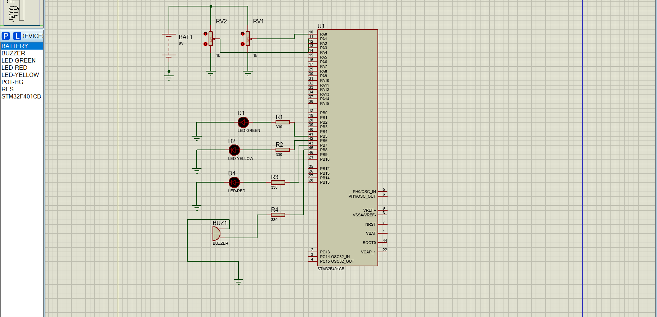
Block diagram

Slide 7
Components used
S.No. | Component Name | Quantity | Specification
1 | STM32F401CB Microcontroller | 1 | 32-bit ARM Cortex-M4
2 | Battery | 1 | 9V DC
3 | Potentiometer (RV1) | 1 | 1 kΩ
4 | Potentiometer (RV2) | 1 | 1 kΩ
5 | Green LED | 1 | LED Indicator
6 | Yellow LED | 1 | LED Indicator
7 | Red LED | 1 | LED Indicator
8 | Resistors (R1–R4) | 4 | 330 Ω each
9 | Buzzer | 1 | Audio Alert
10 | Ground Terminal | As required | Circuit Grounding
11 | Connecting Wires | As required | Electrical Connections

Slide 8
Working Principle:
The circuit is designed using the STM32F401CB microcontroller to monitor analog input signals and indicate different operating conditions through LEDs and a buzzer.
1. Power Supply: The 9V battery provides the input power supply to the circuit. A suitable regulated voltage supply is required for the STM32 microcontroller to operate safely.
2. Input Signal Generation: Two 1 kΩ potentiometers (RV1 and RV2) are used to generate variable analog input voltages. These voltages are supplied to the analog input pins of the STM32 microcontroller.
3. Analog Signal Processing: The STM32F401CB microcontroller receives the analog input signals and converts them into digital values using its built-in Analog-to-Digital Converter (ADC).
4. Condition Monitoring: The microcontroller compares the converted ADC values with predefined threshold levels to identify the operating condition of the system.

Slide 9
5. LED Indication: Three LEDs are used to indicate different operating conditions:
Green LED: Indicates normal operating condition.
Yellow LED: Indicates warning or intermediate condition.
Red LED: Indicates critical or abnormal condition.
6. Buzzer Operation: When the input value reaches a predefined critical threshold, the microcontroller activates the buzzer to provide an audible warning.
7. Output Control: The STM32 microcontroller controls the LEDs and buzzer through its GPIO output pins according to the detected input conditions.
8. Simulation: The complete circuit is designed and simulated using Proteus 8 Professional. By varying the potentiometer values, different input conditions can be observed through the LED indications and buzzer response.

Slide 10
Software architecture
The software architecture of the proposed system is based on the STM32F401CB microcontroller. It is designed to acquire analog input signals from potentiometers, process the signals using the ADC module, and control the output devices such as LEDs and a buzzer according to predefined threshold values.
1. Input Acquisition Module
Two 1 kΩ potentiometers are used to provide variable analog input signals.
The analog signals are connected to the ADC input pins of the STM32F401CB.
The ADC module reads the input voltage and converts it into digital values.
2. ADC Processing Module
The microcontroller uses its built-in 12-bit ADC to convert analog signals into digital data.
The converted values are stored in variables for further processing.
The ADC readings are continuously monitored to identify changes in input conditions.
3. Threshold Comparison Module
The digital ADC values are compared with predefined threshold levels.
Based on the comparison, the system identifies normal, warning, and critical operating conditions.
This module determines which output device should be activated.

Slide 11
4. LED Control Module
GPIO output pins are configured to control the green, yellow, and red LEDs.
The green LED indicates normal operation.
The yellow LED indicates a warning condition.
The red LED indicates a critical condition.
5. Buzzer Control Module
The buzzer is controlled through a GPIO output pin.
When the input value exceeds the critical threshold, the microcontroller activates the buzzer.
It provides an audible alert to indicate abnormal operating conditions.
6. Main Control Module
The main program initializes the GPIO pins and ADC peripherals.
It continuously reads the analog input values.
It performs threshold comparison and updates the LED and buzzer outputs.
The process repeats continuously to provide real time monitoring

Slide 12
Anomaly detection dashboard
The Anomaly Detection Dashboard provides a visual interface to monitor the health of radar equipment by displaying temperature, vibration levels, and abnormal operating conditions.Key Features:- Temperature Monitoring: Displays the current equipment temperature in °C.- Vibration Monitoring: Displays vibration levels to identify unusual movements.- Equipment Health Status: Indicates whether the equipment is Normal, Warning, or Critical.- Anomaly Alerts: Highlights abnormal temperature or vibration readings.- Real-Time Visualization: Displays sensor readings and trends using graphs.- Historical Data: Stores previous readings to help analyze equipment performance, if data logging is implemented.

Slide 13
Application
1. Radar Systems: Monitoring the temperature and vibration of radar equipment.
2. Electronic Enclosures: Detecting abnormal operating conditions inside electronic cabinets.
3. Defence Equipment: Supporting equipment health monitoring in defence electronics.
4. Communication Systems: Monitoring the operating conditions of communication equipment.
5. Industrial Automation: Identifying abnormal temperature and vibration in industrial control units.
6. Predictive Maintenance: Helping maintenance teams identify potential faults at an early stage.

Slide 14
Advantages
1. Real-Time Monitoring: Continuously monitors equipment operating conditions.
2. Early Fault Detection: Identifies abnormal temperature and vibration levels.
3. Reduced Downtime: Helps prevent unexpected equipment failures through early warnings.
4. Improved Reliability: Supports reliable operation of electronic equipment.
5. Reduced Manual Inspection: Minimizes the need for frequent manual checking.
6. Easy Visualization: Displays equipment health status through LEDs and a monitoring dashboard.
7. Cost-Effective Solution: Uses sensors and a microcontroller for equipment condition monitoring.

Slide 15
Conclusion
- The Smart Radar Equipment Health Monitoring System helps monitor the operating conditions of radar equipment and electronic enclosures.
- Temperature and vibration sensors can be used to identify abnormal operating conditions.
- The microcontroller processes sensor data and detects anomalies based on predefined threshold values.
- LED indicators and a monitoring dashboard can provide clear information about equipment health.
- This system supports early fault detection, improves equipment reliability, and helps reduce unexpected downtime.

Slide 16
Future scope
- AI-Based Anomaly Detection: Implement machine learning algorithms to identify complex equipment faults.
- IoT-Based Monitoring: Enable remote monitoring of equipment through the internet.
- Cloud Data Storage: Store sensor readings for historical analysis and performance tracking.
- Mobile Notifications: Send alerts to maintenance personnel when abnormal conditions are detected.
- Predictive Maintenance: Analyze historical data to predict possible equipment failures.
- Advanced Sensor Integration: Add vibration, humidity, voltage, and current sensors for comprehensive equipment monitoring.

